Slide 1

Chronic Diseases
Praveen Tata
Samreen Nayeem
Nikhil Nandakumar
Final Presentation

Slide 2
Overview
What is a Chronic Disease?
Most diseases that lasts for a period longer then 3 months
Why is a Data Warehouse required for chronic disease data?
Eighty-six percent of all health care spending in 2010 was for people with one or more chronic medical conditions.
The total cost of arthritis and related conditions was about $128 billion in 2003. Of this amount, nearly $81 billion was for direct medical costs and $47 billion was for indirect costs associated with lost earnings.
How will it help?
Collecting and reviewing Chronic Disease Data in a Data Warehouse, will help doctors and medical institutions isolate the areas where certain Chronic Diseases are prevalent and help focus resources relating to that disease in those areas. This will help reduce and control the number of affected people, resulting in reduced personal medical costs and an overall improvement in the economy.

Slide 3
Business Need
Which parts of United States are susceptible to certain diseases
Demographic divison of diseases
Based on gender and/or race, which diseases have been the main drivers of mortality rate
Year-on-year increase in incidence of diseases in a given region over a given timeframe
Helps us understand which age groups and locations have a higher chance of being affected by specific diseases.

Slide 4
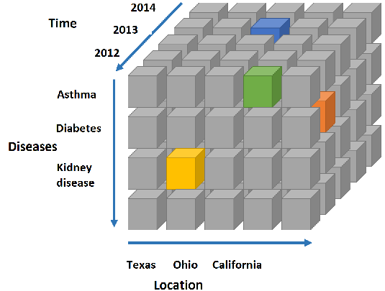
Dimension Cube

Slide 5
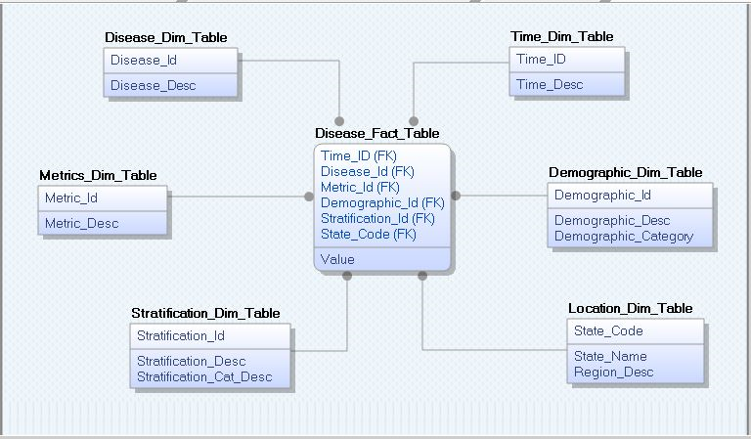
Data Cube

Slide 6
Data Staging
Source Data
Extraction & Cleansing
Standardization
Reporting & Analysis
Retrieved the raw data from the www.data.gov website
Extracted the data from the spreadsheet and loaded it into Database Tables.
Cleansing performed to trim spaces and encode certain field values
Staging data transformed into dimension and fact tables using snowflake schema
Standardization of questions across diseases
Filtering out questions with no response
Fact measures and dimensional attributes combined to create a reporting view for OLAP analysis
Spreadsheet
Oracle Database

Slide 7
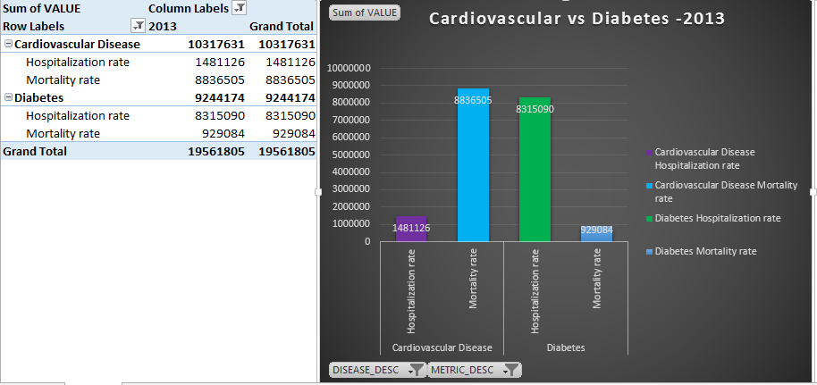
Cardiovascular vs Diabetes
This graph shows the comparison between Cardiovascular Disease vs Diabetes.
Drilling down further, the graph compares hospitalization vs mortality for both diseases for the year 2013.
Conclusion –
More people died because of cardiovascular disease as compared to diabetes.
On the other hand more people were hospitalized due to diabetes.

Slide 8
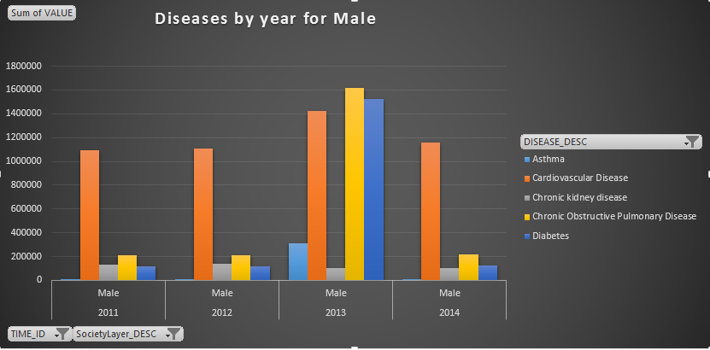
Diseases by Year for Male Patients
The graph shows comparison of mortality rate due to various diseases like Asthma, Cardiovascular, Chronic Kidney, Diabetes and other diseases.
The comparison shows the mortality rate of Males in different years.
As we can see, the number of Males who died due to these disease increased every year.
We can see a little decline in the year 2014 which shows, Males are also becoming health conscious.

Slide 9
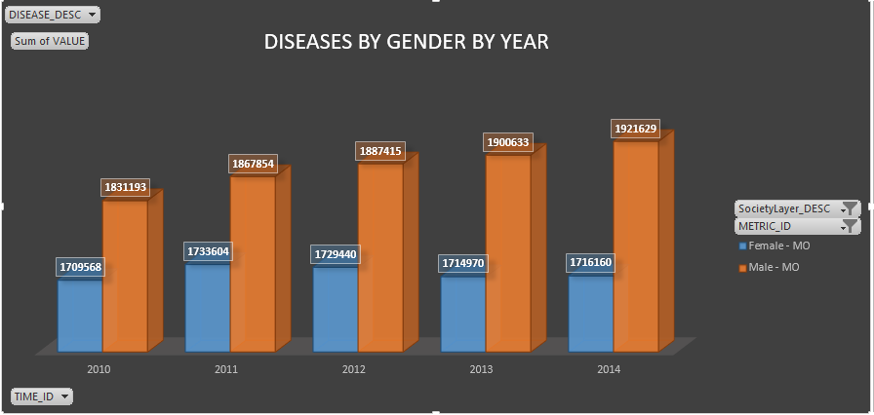
Diseases by Gender per Year
This graph shows comparison of mortality rates of Male and Female by year.
This graph shows that more females died due to different chronic diseases.
The number of females and males increased every year.

Slide 10
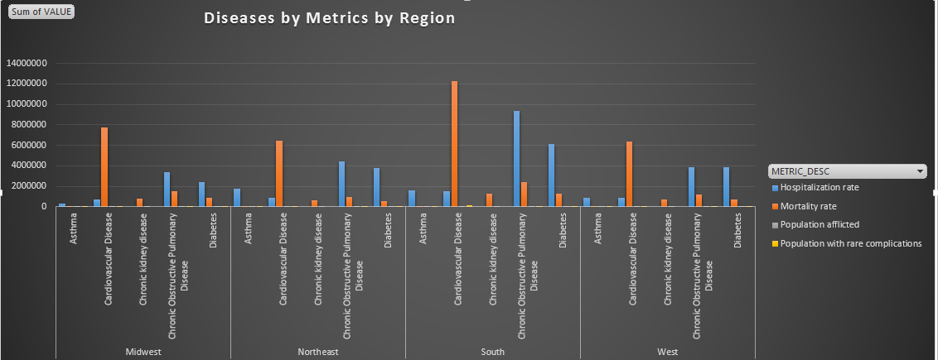
Diseases and their affects by Metrics per Region

Slide 11
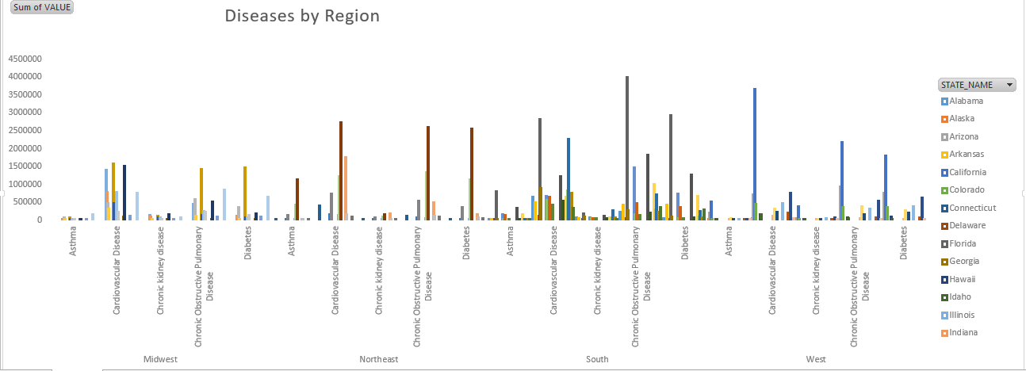
Diseases by Region

Slide 12
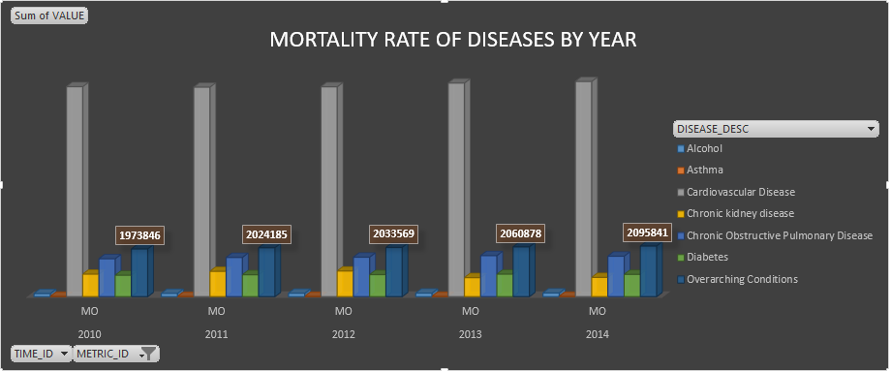
Mortality Rate of Diseases by Year
The graph shows the number of people who died because of different diseases by year.
The number is increasing every year.
Fatalities due to cardiovascular diseases is the most.

Slide 13
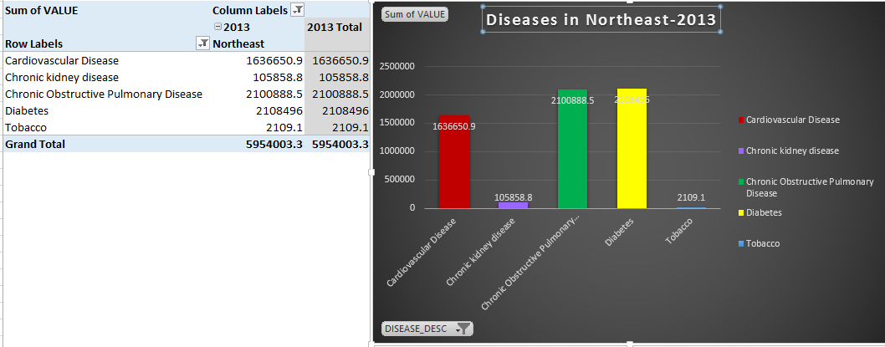
Diseases per Year (2013) for Northeast region
The graph shows the mortality rate in the Northeast region in year 2013 for different disease.
Fatalities due to Cardiovascular and Chronic Pulmonary diseases are the most.

Slide 14
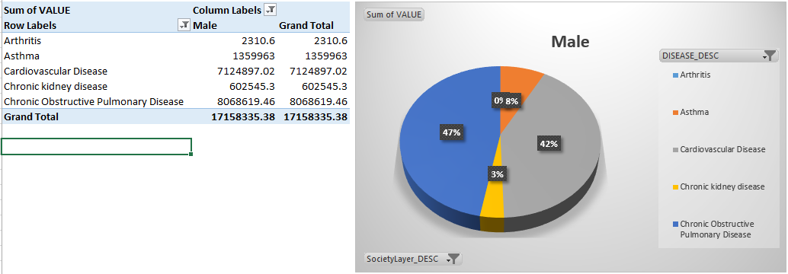
Pie Chart – Overall Mortality Rate of Male
Overall male mortality rate by different disease.
Cardiovascular and Obstructive Pulmonary disease have the most affect – 47% and 42% respectively.

Slide 15
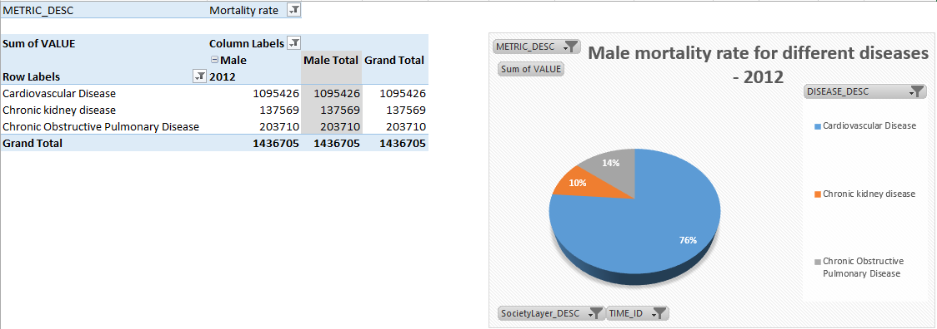
Mortality Rate for specific diseases for a select Year
The pie chart shows number of males who died because of listed diseases in the year 2012.

Slide 16
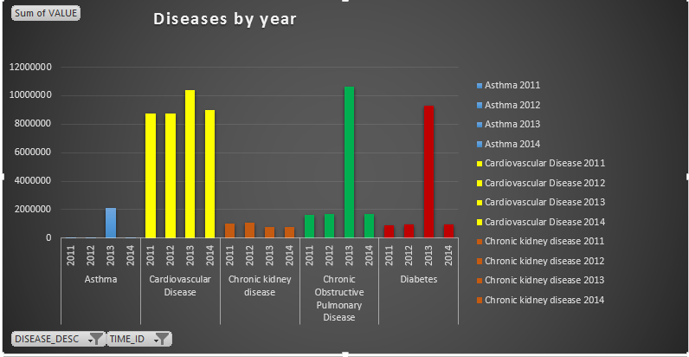
Overall Disease Mortality Rate by Year
The graph shows the comparison of the number of people who died from year 2011 – 2014.
The graph also compares the mortality rate from year 2011-2014 of various diseases.

Slide 17
Key Insights
Gradual decline in Lifestyle diseases (e.g. Diabetes, Cardiovascular) over the past 5 years indicates a trend towards a healthier lifestyle.
Cardio vascular diseases have a high mortality rate but low hospitalization rate. This may imply that there is a need for Medical Institutions to increase awareness of the sudden effects of such diseases. This will allow more people to get checked up and over time reduce the mortality rate of such a disease.
Southern Region is more prone to heart diseases than other regions hence allowing institutions to work towards reducing such diseases in those regions.

Slide 18
Conclusion
As can be clearly seen with the results acquired from the various reports, a data warehouse can take a huge collection of raw data and convert this data into user-friendly analysis data, allowing business users to utilize such information to further improve their organization.
In our case, the data allows medical institutes to query the data warehouse and help understand the various chronic disease trends in America and take necessary action to help reduce the mortality rate and hospitalizations caused by these diseases.
This report has not only helped us understand the usage of a data warehouse but taught us how to execute and see the benefits in real-time.

Slide 19
References
https://www.cdc.gov/chronicdisease/overview/

Slide 20

Thank You

